Slide 1
CS 4530: Fundamentals of Software Engineering Lesson 2.4 The Object Scale
Jonathan Bell, Adeel Bhutta, Ferdinand Vesely, Mitch Wand
Khoury College of Computer Sciences
© 2022 Released under the CC BY-SA license

Slide 2
Learning Goals for this Lesson
At the end of this lesson, you should be able to
Demonstrate the basics of UML class diagrams
Explain the significance of the different kinds of associations in UML
Explain what the reviewer of a design might want to know that UML leaves out
Notes:
<read slide>

Slide 3
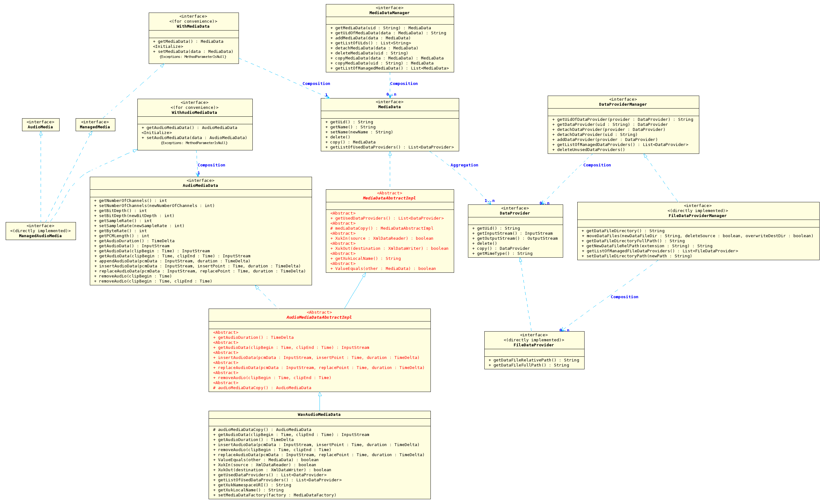
This is the scale of UML diagrams
Notes:
Last, let’s look at the lowest scale of design, where we can express more of the fine details of our design.
This corresponds roughly to the scale of UML diagrams.

Slide 4
UML in the context of this course
There are numerous tools for translating from UML to code (or code fragments), and vice versa, BUT
We are interested in UML as a human-to-human language.
In general, we expect your UML diagrams to "look like" UML diagrams, but we are not interested in every last detail of the notation.
We just want your diagrams to communicate the important things, with detail as necessary.
It will not be satisfactory to simply rely on some UML-generation tool. That will only demonstrate that you haven't thought hard about the problem ☺
Notes:
We are interested in UML as a human-to-human communication language, just as our previous design languages were: your goal is to be able to communicate your design to your teammates (and vice versa).
Our previous design languages had a vocabulary of words, so you could describe your design in a document or an email. The main role of UML is to help you describe your design on a whiteboard. If you’ve walked around any of our labs, you’ve probably seen some UML diagrams on whiteboards. We assume you know enough to understand what you’ve seen there, more or less.
<read last two bullets>

Slide 5
3 Levels of UML
Level 0: The Types (aka: Classes and Interfaces)
Level 1: Relationships between types (aka "associations")
Level 2: Attributes and Methods (aka Properties)
Notes:
For the purposes of this lesson, we can think about UML at three levels of detail:
<read slide>
Each level gives more detail than the last. As usual, you will always have to choose what details to include and what to exclude, depending on what you are trying to communicate.

Slide 6
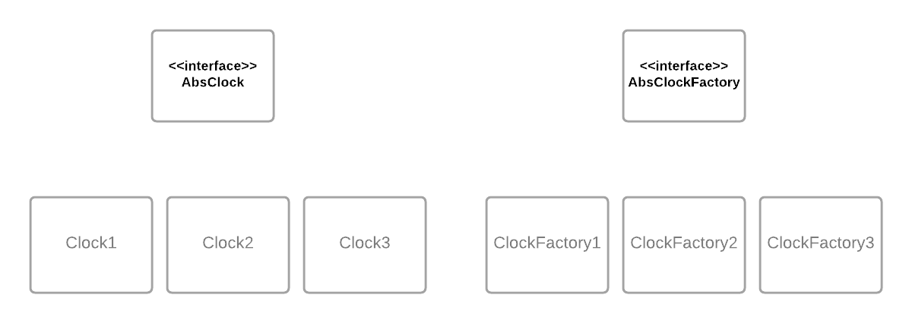
Level 0: Types (Interfaces and Classes)
Notes:
The simplest picture simply shows the interfaces and classes in the program, without showing how they are related. Interfaces and Classes are both represented as rectangles; interfaces are marked with <<interfaces>>, as they are here; sometimes interfaces are indicated by writing their name in italics.
Here we've laid out the types in a way that suggests some relationships, but we haven't actually shown those relationships.
Sometimes that’s all you need.

Slide 7
Level 1: Relationships
Some different kinds of relationships
implements
SimpleClock implements AbsClock
depends-on (or refers-to)
ClockClient depends-on AbsClock
subclass-of (or inherits-from)
(use alternate impl of ClockFactory)
Associations
7
Notes:
The next level of detail is to depict some of the relationships between the classes and interfaces. The most important kinds of relationships are:
<read first three bullets>
These 3 are “structural” relationships, reflect the internal structure of the code.
The fourth kind of relationship, called “Associations”, are different– they reflect facts or relationships in the real world. For these, we will have choices in how to represent them.
Let’s look at some examples.

Slide 8
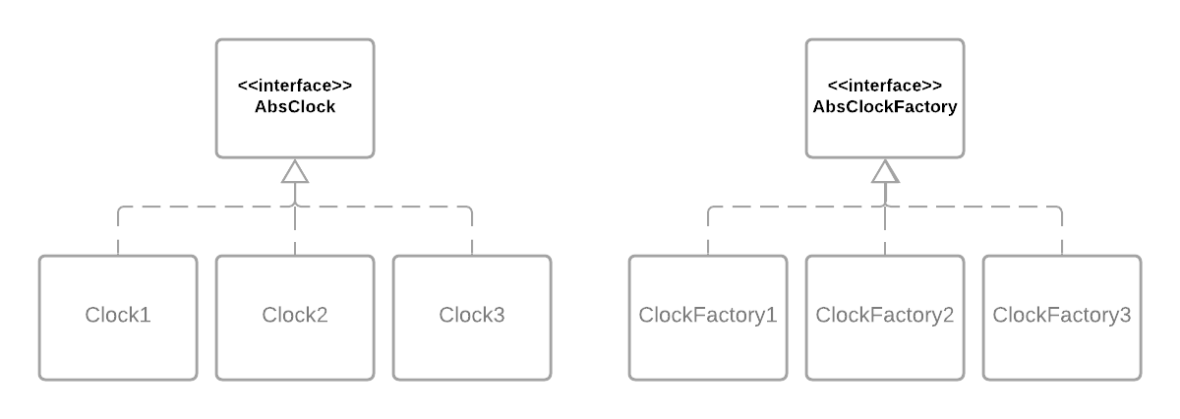
"Implements" relationship
Notes:
Our first relationship is the “implements” relationship. This is typically denoted by a dashed line with a large open-faced triangle at the end.
This arrow signifies “implements” in the code. So here we are depicting facts like “Clock1 implements AbsClock”.

Slide 9
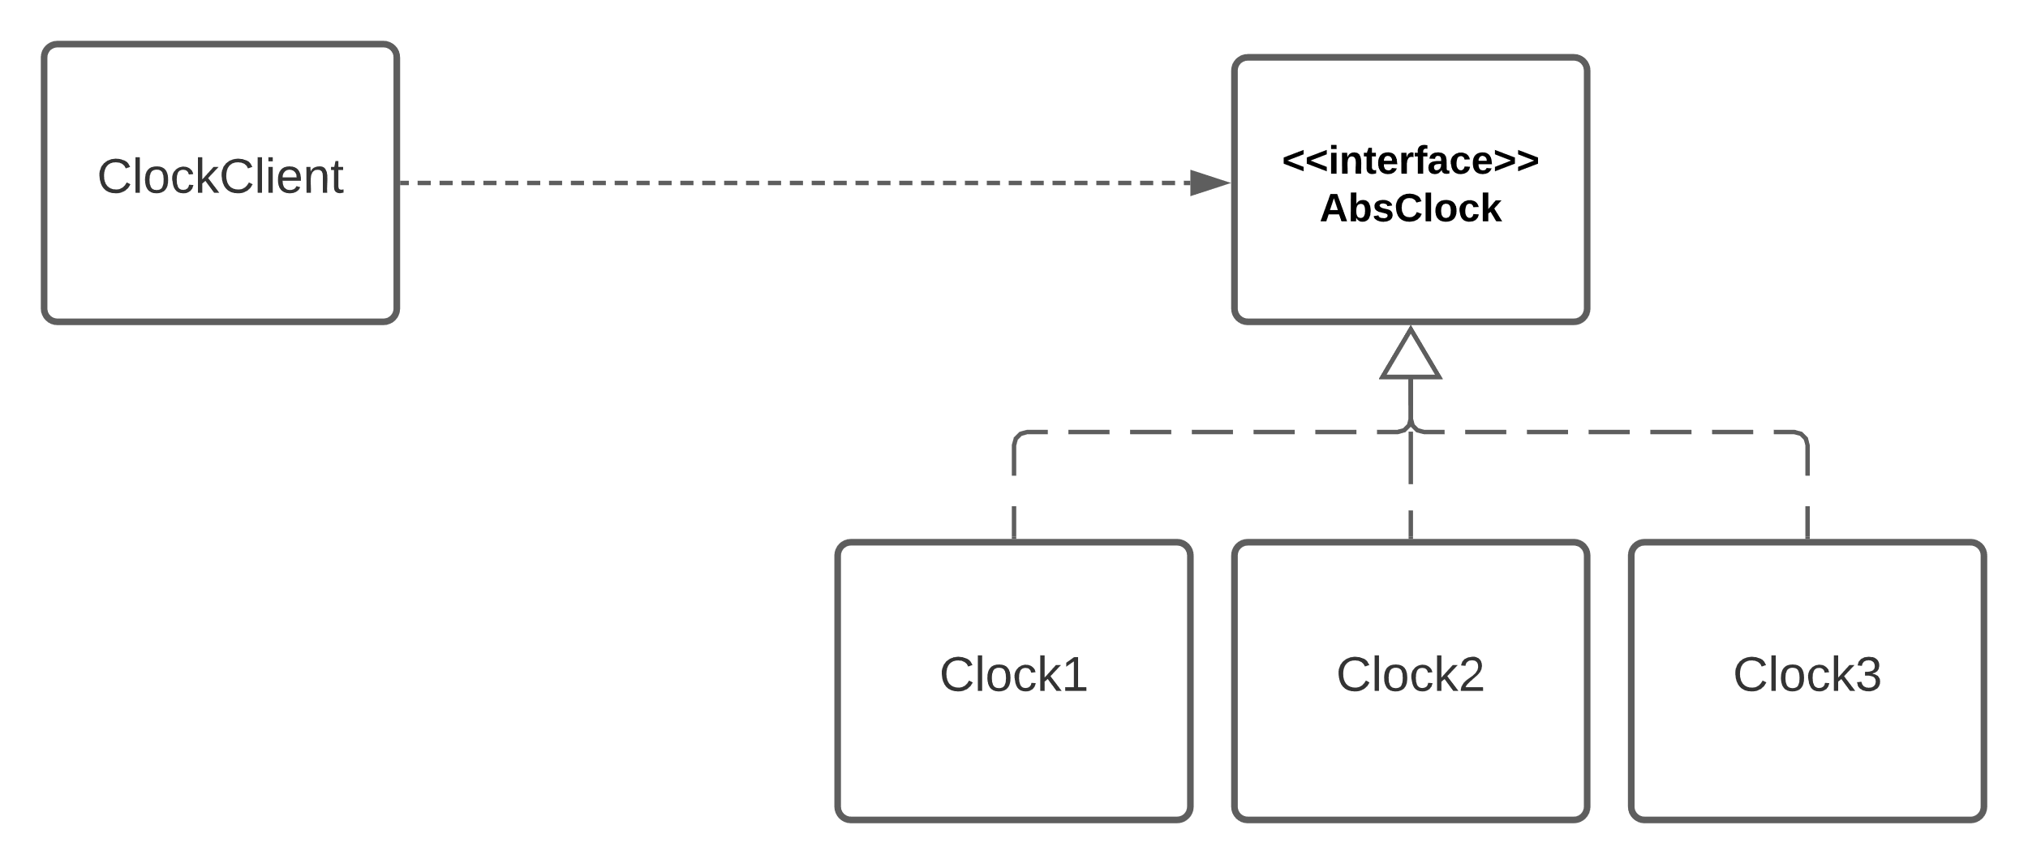
"Depends on" relationship
export class ClockClient {
constructor (private theclock:AbsClock) {}
getTimeFromClock ():number {return this.theclock.getTime()}
}
Notes:
The next relationship is “depends on”. One class depends on another if it contains a reference to it. Here, ClockClient says “theClock:AbsClock”, so it contains a reference to AbsClock. A depends-on relationship is typically depicted by a dotted line and a solid arrow.
Note that here, a ClockClient knows that it will see an object satisfying the AbsClock interface, but it doesn't know whether that object is a Clock1, a Clock2, or a Clock3. It doesn’t depend on Clock1, Clock2, or Clock3; it only depends on AbsClock. By using AbsClock, we've reduced coupling. Remember that this is called “Dependency Inversion” (I don’t find that name very helpful, but it’s one of those vocabulary words you should be able trot out when appropriate).

Slide 10
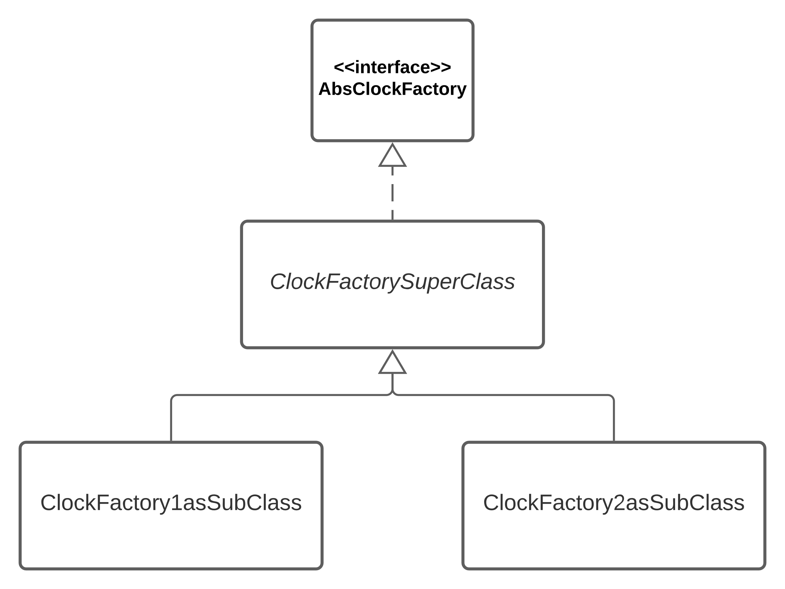
"inherits-from" relationship in UML
Notes:
Next is the inherits-from or “extends” relationship. This is typically indicated by a solid line terminated by an open-faced triangle.
Here we express the facts that ClockFactory1asSubClass and ClockFactory2asSubClass both extend ClockFactorySuperClass, and ClockFactorySuperClass implements AbsClockFactory.

Slide 11
Associations
An association is a relationship between two objects that indicates a link or dependency between them.
Examples:
a portfolio is associated with an investor
every sale is associated with the sales representatives that worked on the sale
every student is associated with a transcript
An associations typically has a name that indicate its meaning in the real world
An association typically has a cardinality that indicates whether it is a 1:1 relation, a 1:many relation, etc.
11
Notes:
The three relationships we’ve talked about refer to facts about the code.
More generally, an association reflects a fact or assumption about the world that we are representing. For example: <read three example bullets>
<read rest of slide>

Slide 12
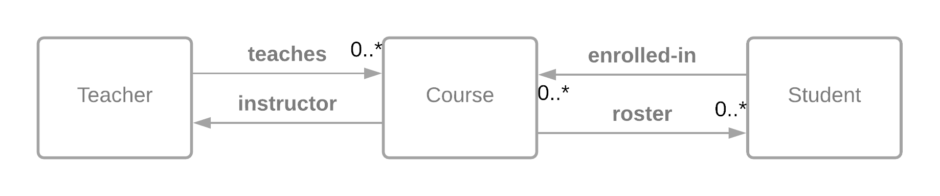
Associations
Each teacher teaches zero or more courses.
Each course has exactly one instructor
Each student is enrolled in zero or more courses
Each course has zero or more students enrolled
Notes:
Here’s an example. <read slide>

Slide 13
Associations in Code
class Teacher {
coursesTaught : Course[]
}
class Course {
instructor : Teacher
roster : Student[]
}
class Student {
classesTaking : Course[]
}
// INVARIANT:
// c.instructor = t iff c is in t.coursesTaught
// s in c.roster iff c is in s.classes
Notes:
Here’s an example showing how these associations are represented in the code.
<read code>
It’s probably the case that we expect these relations to be consistent. That is, a teacher teaches a course if and only if they are the instructor of that course, etc.
That is not directly expressed in the UML; here we’ve expressed this consistency condition as an invariant that we expect the code to maintain.

Slide 14
Properties of Associations: Cardinality (or Multiplicity)
The relationship between two entities has an associated cardinality or multiplicity
multiplicity is expressed with specific numbers or ranges,
e.g.: 1:1..2 or 1:1..N
Examples:
A student is associated with exactly one transcript (1:1)
One student, one transcript.
Every course is taught by a professor, but a professor must teach at least one course (1:1..*)
One course, one professor. One professor, one or more courses.
An address may have a zip code (1:0..1)
One address, zero or one zip code
14

Slide 15
Notation for Cardinality in Associations
Instructor
teaches ►
Course
Any given instructor teaches 1 course. Any given course is associated with one instructor.
1
1
Instructor
teaches ►
Course
Any given instructor teaches at least 1 and up to 10 courses. Any given course is associated with one instructor.
1
1..10
Instructor
teaches ►
Course
Any given instructor teaches 1 or more courses. Any given course is associated with one instructor.
1
1..*
Note: the solid triangle indicates how a human should interpret the relationship ("Instructor teaches Course"). It does not indicate navigability (from an instructor, can you find the list of courses they teach?)
Instructor
teaches ►
Course
If no cardinality is specified, it defaults to 1.
1..*
15
Notes:
Here’s more about cardinalities. This is all pretty self-explanatory. You should study this slide and let me know if you have any questions.

Slide 16
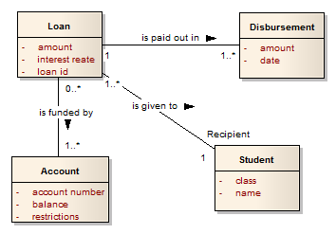
Associations should reflect something about the real world
Partial Translation:
We have discovered that a loan can be paid out in multiple disbursements. There does not appear to be any limit to the number of disbursements. In addition, each loan is given to a single student. Apparently, students cannot share loans.
16
Notes:
We can use cardinalities to reflect relatively complex situations and invariants in the real world.

Slide 17
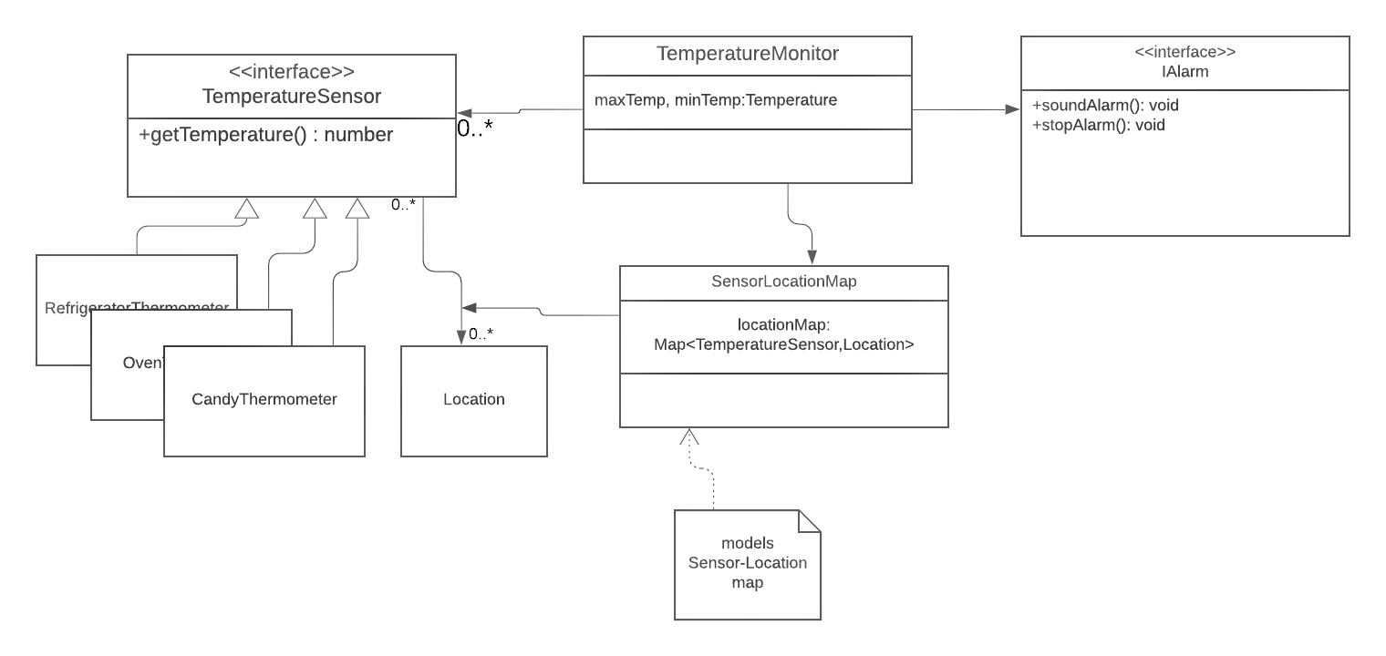
What world are we modeling?
Sometimes the world we are modeling is not the real world, but the world of entities in our program
Discussion Question: Which parts of this chart represent things in the real world, and which parts represent things that only live in our computers?
17
Notes:
UML can be used in a variety of ways. Sometimes it is used to model assumptions about the real world, as it was on the preceding slide, but we are usually more interested in using it to explain the design of our code, that is to say, the world of entities in our program.

Slide 18
Associations in Code, again
Discussion Question: What real-world things do these classes and associations represent?
class Teacher {
coursesTaught : Course[]
}
class Course {
instructor : Teacher
roster : Student[]
}
class Student {
classesTaking : Course[]
}
// INVARIANT:
// c.instructor = t iff c is in t.coursesTaught
// s in c.roster iff c is in s.classes
Notes:
Now, let’s go back to our General Design Principle #2: Make Your Data Mean Something.
This diagram is a fine representation of facts about the classes and properties in our code.
But it’s not very good at explaining what an object of one of those classes represents in the real world.
Does Course represent something like CS4530? But there's a roster there, so probably it represents a particular offering of CS4530 (e.g. CS 4530 in Spring 2022). But does it represent the whole course, or only one section?
And ditto for Teacher and coursesTaught.
Or maybe this entire diagram is meant to represent a snapshot of faculty, courses, and students at a particular point in time.
All of these things need to be documented somewhere. UML has Remarks boxes, which play the role of comments. Maybe that’s where this information should have been, or maybe it best fits somewhere else– it all depends on who is reading the diagram, and what they need to know.

Slide 19

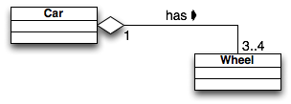
Discussion: what do Car and Wheel represent?
A car has 3–4 wheels
The solid arrow indicates the way we should read "has" (a car "has" wheels, not wheels "has" a car).
Discussion Question: What should the navigability of this association be? Should we be able to get from a Car to the Wheels that it has? Should we be able to get from Wheel to Car?
19

Slide 20
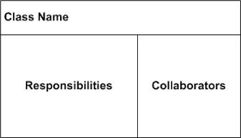
Interlude: CRC Cards are a lighter-weight alternative to UML for initial design
Class
the name of a "thing" in your program
could be a class, interface, type, etc.
Responsibilities
the main job of this "thing" in the program
should be simple: Remember the Single Responsibility Principle
Might be “Manages <some piece of state>”
Collaborator
Any class or interface that this class needs in order to fulfill its responsibilities
Goal is to make sure that each class has enough information to fulfill its responsibilities.
Good for early-stage planning and design

Slide 21
CRC Cards in Practice
Typically used during early analysis, especially during team discussions.
Low-tech
4x6 index cards
They aren't pretty.
They aren't something you ever want to show your customers or even your own upper management.
Each card is a concrete symbol for a thing in the program during discussion
Kind of like thinking on a whiteboard, but...
Cards can be stacked, moved, etc. to illustrate proposed relationships
If you come out of a group meeting and your CRC cards aren't smudged, dog-eared, with lots of scratched-out bits, you probably weren't really trying.
https://www.cs.odu.edu/~zeil/cs330/live/website/Slides/crc/page/crc.html

Slide 22
Back to UML: Level 2: Attributes, Methods, and Names
A Class is drawn as a three-part box containing:
class name (required)
list of attributes with names and types (optional)
list of methods with argument lists (optional)
Attributes and methods may be annotated with "+" for public and "-" for private.
Components with special roles may be annotated with "stereotypes", which are written with <<...>>.
Name
Attribute₁ : type₁
Attribute₂ : type₂
method₁ (signature) : type₁
method₂ (signature) : type₂
22
Notes:
We still haven’t talked about the attributes and methods. We think of these as constituting another level of detail.

Slide 23
Attributes
The attributes of a class are roughly those members (or "instance variables" or "properties", depending on what language you are writing in) whose values are either
scalars ("simple" attributes)
arrays or lists of scalars ("multivalued" attributes)
simple structs (e.g. dates or names)
Class members whose values are full-fledged objects (of this or some other class) are usually represented in UML as relationships.
In TypeScript, functions are values, so for us an attribute could have a value that is a function. Your real-world boss may or may not agree.
Notes:
<read slide>

Slide 24
Methods
If there are many methods, they may not fit in a UML diagram.
Alternatives:
Tables
Javadoc, etc.
Notes:
Last come the methods. If there are many methods, they may not fit nicely into a UML diagram. At that level of detail, there are tools for taking information directly from the source code and turning it into a set of web pages with appropriate links.

Slide 25
This is the level where we specify names
If you are going to write code, you need to know the names of the classes, methods, etc.
Notes:
When we get down to this level of detail, we become interested in the names of things. After all, if you are going to call a method, you need to know its name. And if you are going to define a class or an interface, you need to know the names of the methods you are offering, so other folks can call them.

Slide 26
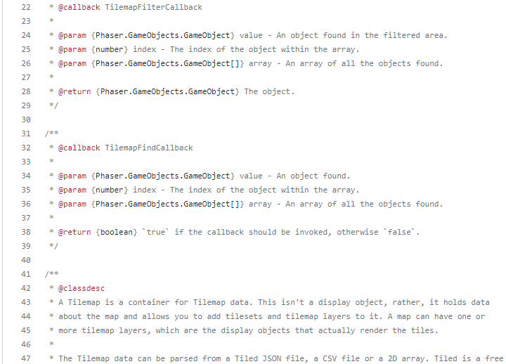
JSDoc
You put structured comments in the code
Notes:
For tools like Javadoc and JSDoc, you document the code with structured comments.

Slide 27
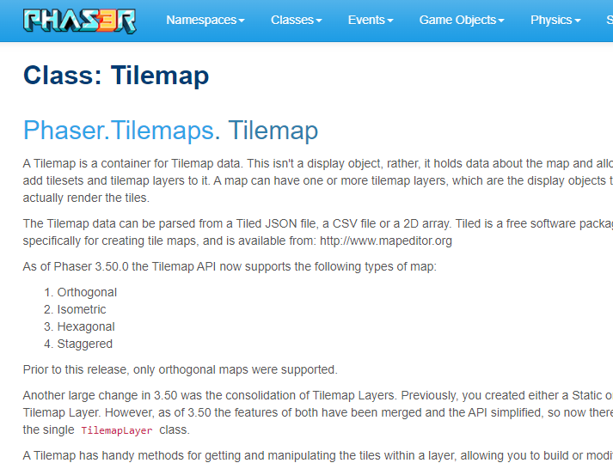
And the tool turns it into web pages
Notes:
And the tool turns it into web pages, with appropriate links. This one, of course, has been heavily customized, but it’s a good way to capture details in a way that is accessible without making the reader grovel through the code.

Slide 28
Here’s our design again, with names.
My file imports ClockFactory from './ClockFactory.ts'
When I create an object that needs a clock, I get a copy of the master clock by calling the static method ClockFactory.instance() , and the new object registers itself with the master clock by calling c.register(this) .
Whenever the master clock changes, it updates my object by sending it a notify(t:Time) message. It also sends my object a similar update message when anyone registers with it, so my object will always have the latest time.
Pat is responsible for ClockFactory.ts . Pat and I agreed on this protocol; Pat agreed that their clock factory will have an instance() method that returns the master clock, and that the master clock will have a register() method that I can use to register my object.
In return, I agreed that my object will have a notify(t:Time) method that the master clock can use to notify it about the updated time.
Notes:
So here’s our design again, at this level of detail. Note the details of the discussion with Pat. You and Pat agreed on the names of the methods, and who supplies what methods.

Slide 29
Review: Learning Objectives for this Lesson
At the end of this lesson, you should be able to
Demonstrate the basics of UML class diagrams
Explain the significance of the different kinds of associations in UML
Explain what the reviewer of a design might want to know that UML leaves out
Notes:
<read slide>

